Slide 1
SESSION -5 SCRAP ART
TEAM NO-26

Slide 2
TEAM MEMBERS:
CH.PALLAVI (EC23B1014)
CH.NAGA BHAVISHYA (EC23B1061)
G.DEAVI SRI ASRITHA VARDHINI (EC23B1002)
N.SUPRIYA (EC23B1002)
S.N.AKSHAYA (EC23B1031)
M.SATHVIKA (EC23B1020)
K.V.MANISH (EC23I2010)
B.DESHIK (EC23B1024)
ARULMOZHI (EC23B1135)
S.RITHANYA (EC23B1120)
M.AKRAM BAIG EC23BI2020)
M.SOMESHWAR RAJ (EC23B1127)

Slide 3
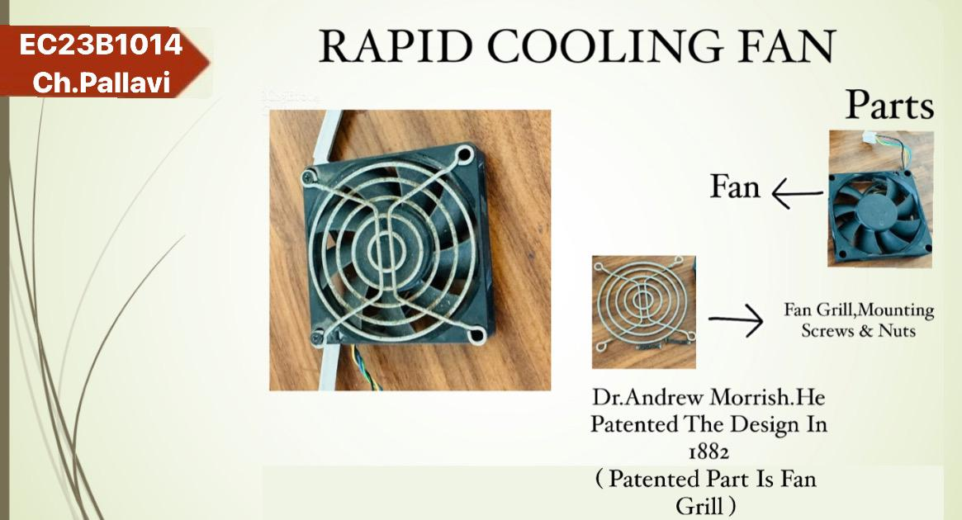

Slide 4
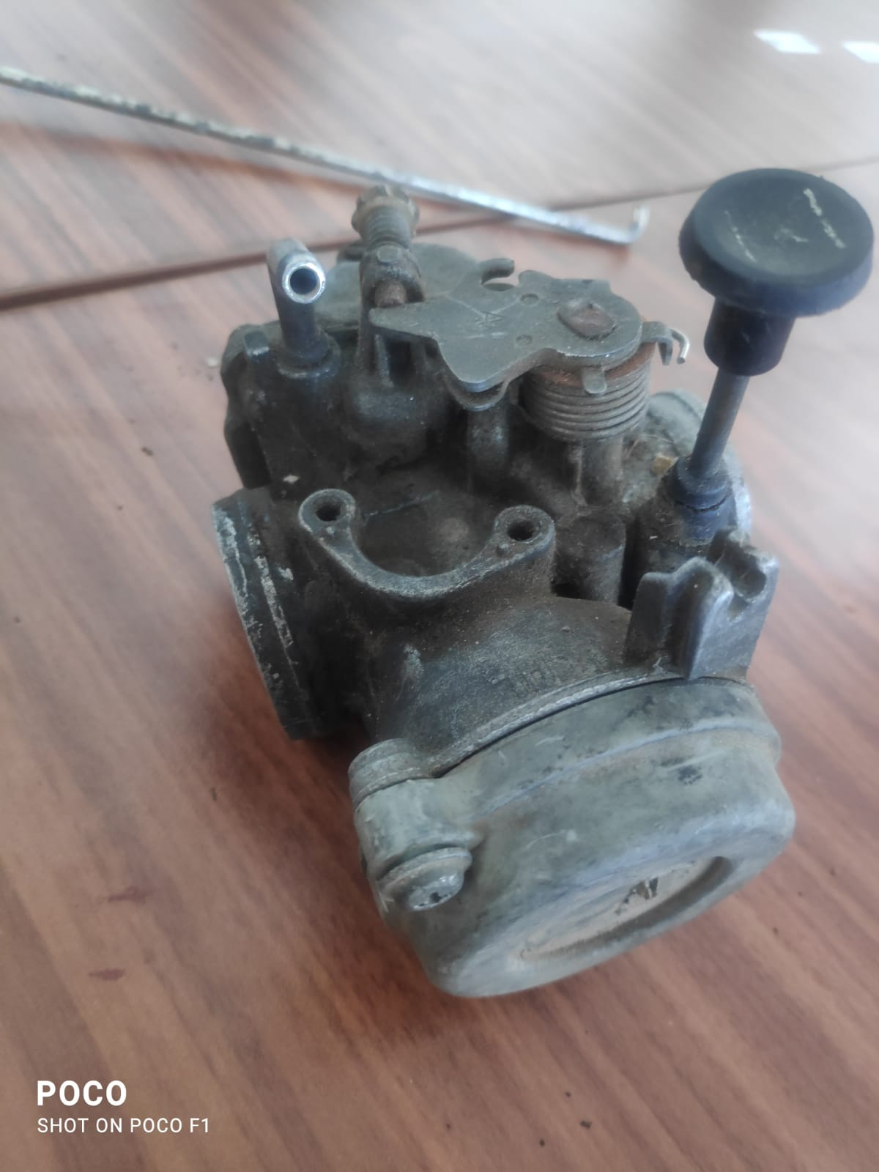
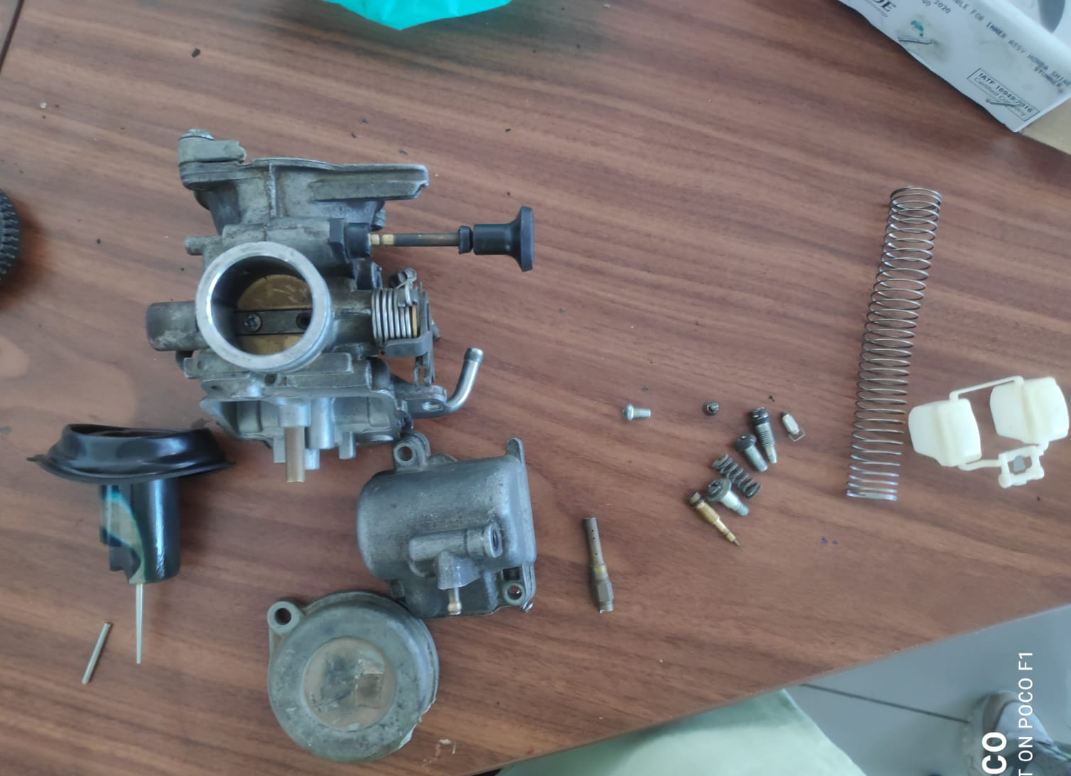
CHALLA NAGA BHAVISHYA
EC23B1061
Carburetor is a device used for supplying a spark ignition
Engine with a mixture of fuel and air.
Karl Benz invented the carburetor in 1885 and patented
It in 1886.
The coil spring was patented by Richard Tredwell in 1763.
CARBURETOR
Main body
spring
float
nuts and screw
pin
Float bowl
slide
cap

Slide 5

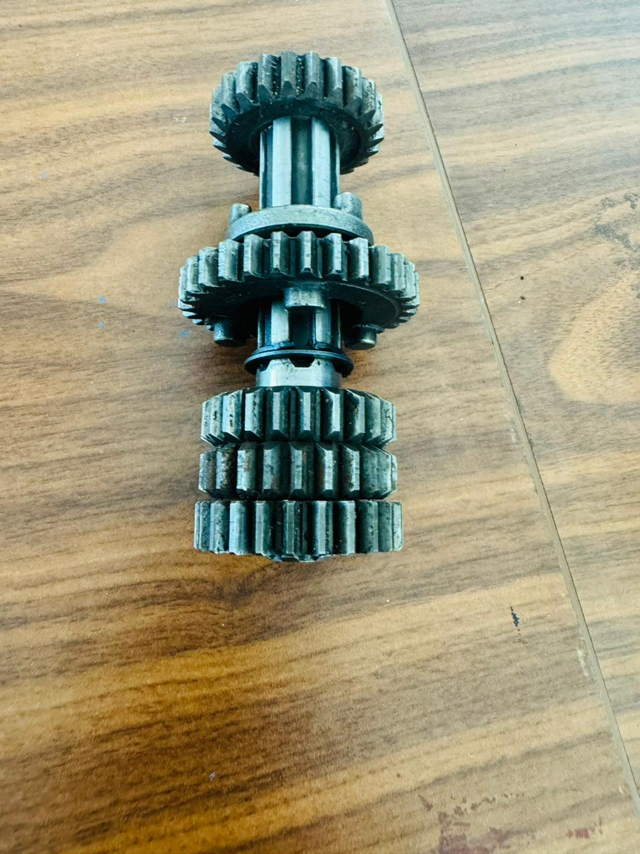
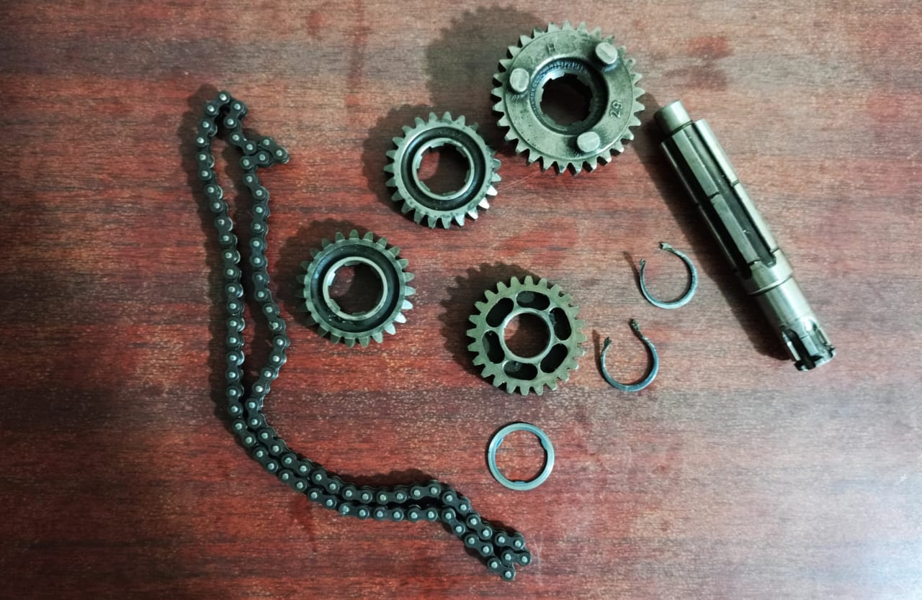
G.DEAVI SRI ASRITHA VARDHINI
EC23B1002
TRANSMISSION(main) GEAR SET
ENGINE GEAR
CHAIN
GEAR M5
COUNTER SHAFT
GEAR C2
CIRCLIP
OLDEST PART:
Counter Shaft patented by Nerstad,K A and Windish,W E,1987.
WASHER

Slide 6
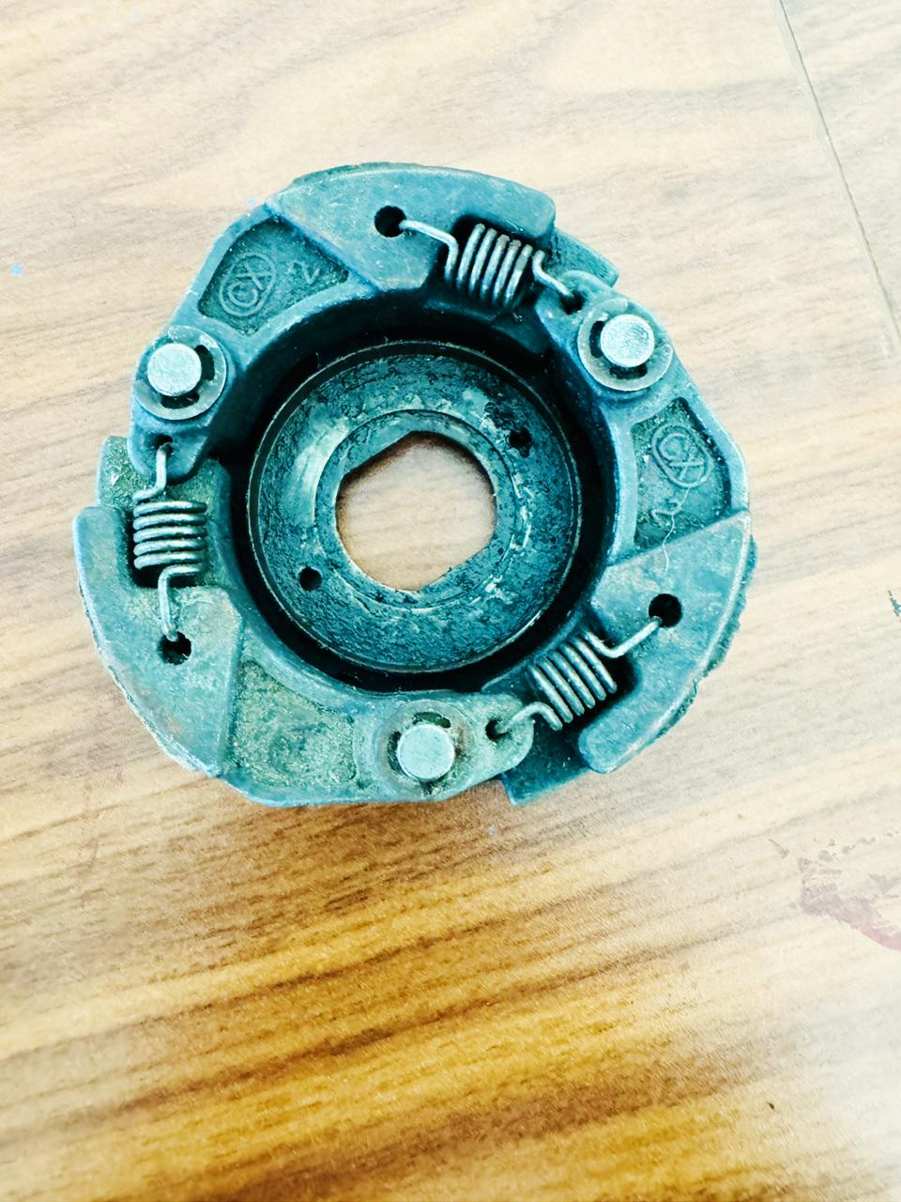
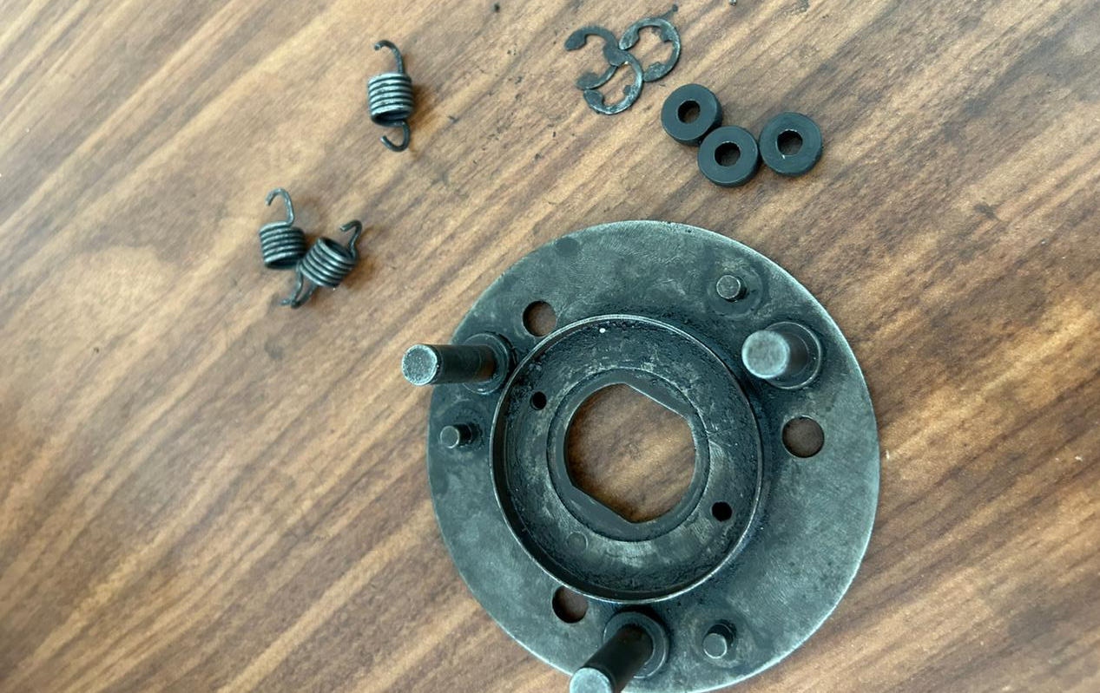
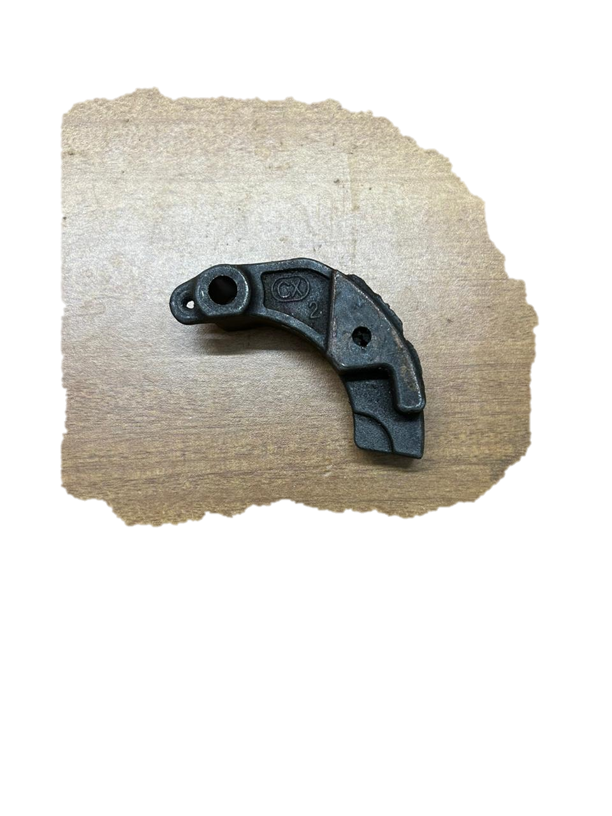
N.Supriya
EC23B1011
Assembly clutch
Circlip e-type
Spring wire
Rubber clutch covers
Patent :
Clutch shoes
US PATENT 5666853a
Ching sheng tsai
September 16,1997.
Brake shoe
Clutch shoe

Slide 7
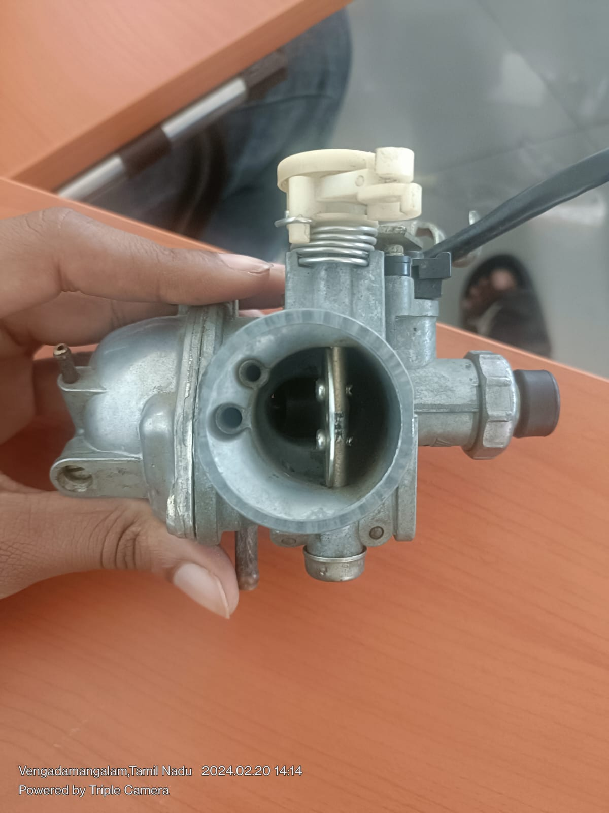
EC23I2010
K.V.Manish
Patented in the year 1886.
Carburetors were invented in 1888 by Karl Benz, one of the founders of Mercedes-Benz. It was a groundbreaking development for the industry at the time, and the technology was used by car manufacturers up until the late 1980s.

Slide 8
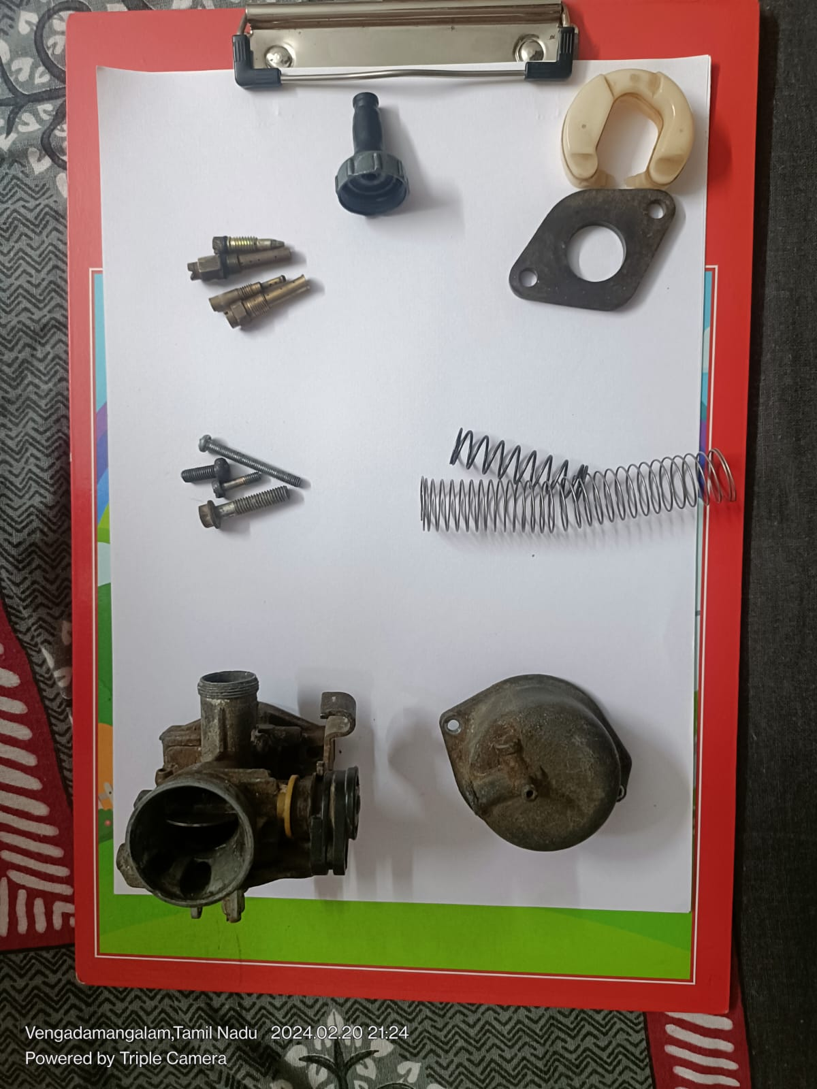
Parts of Carburetor
Screws
Pins
Springs
Main Body
Gasket
Float Bowl

Slide 9
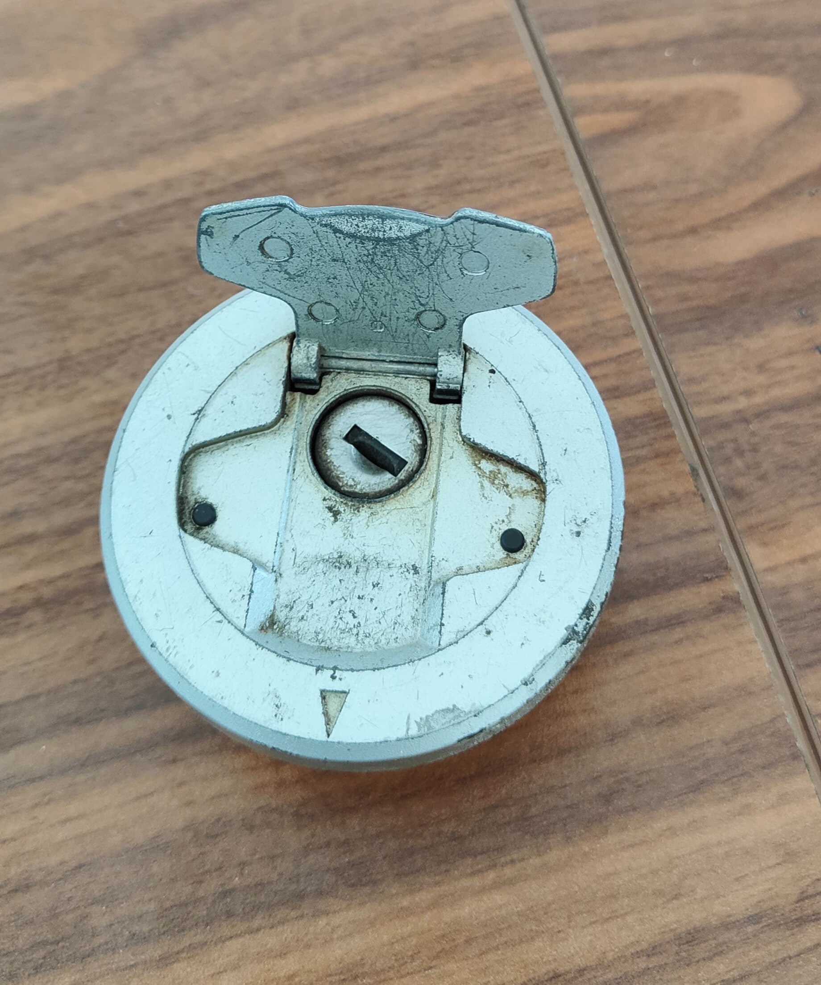
EC23B1024
B.Deshik
The coil spring as we know it today was patented by Richard Tredwell in 1763.
Tredwell received Great Britain Patent
1792 for “Springs For Carriages”.

Slide 10
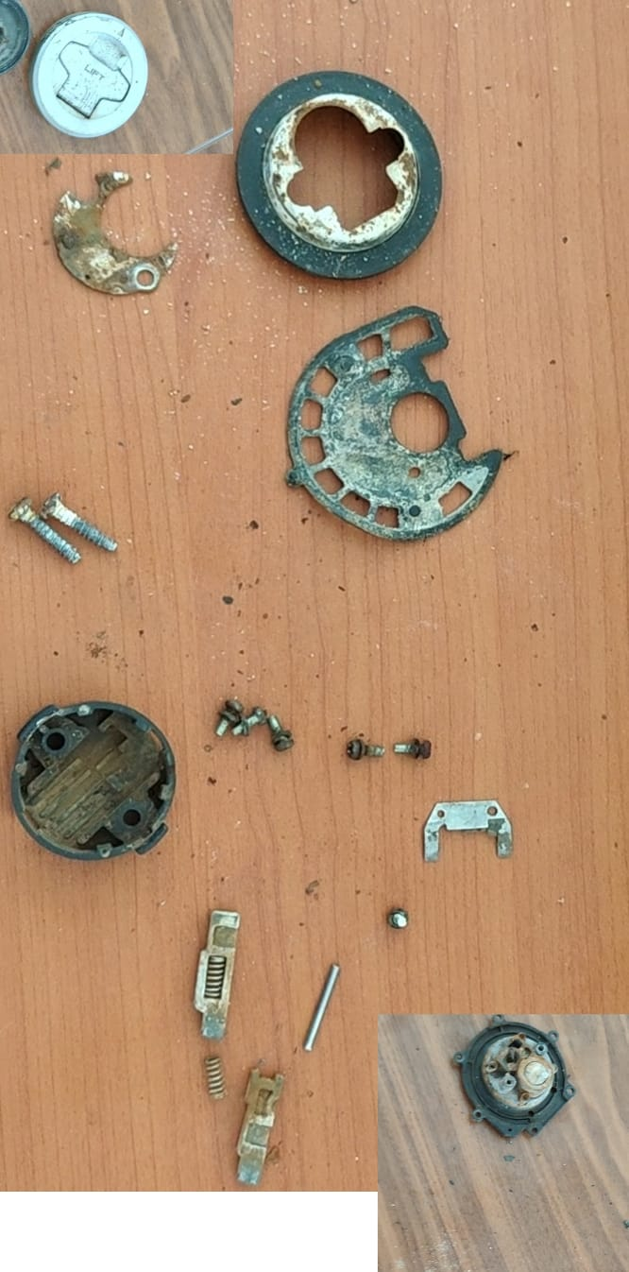
Parts in Locking Fule Cap
Lock System
Rubber
Link
Rim
Pin
Screws
Springs and wafers
Cap
Bottom Cap

Slide 11
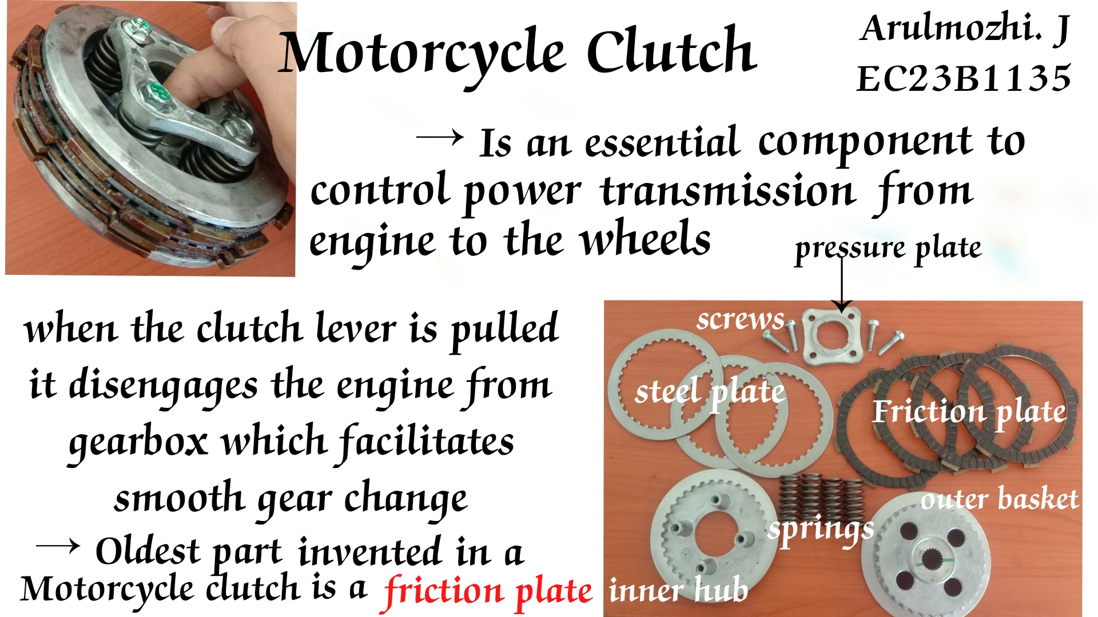
Arulmozhi.J
EC23B1135

Slide 12
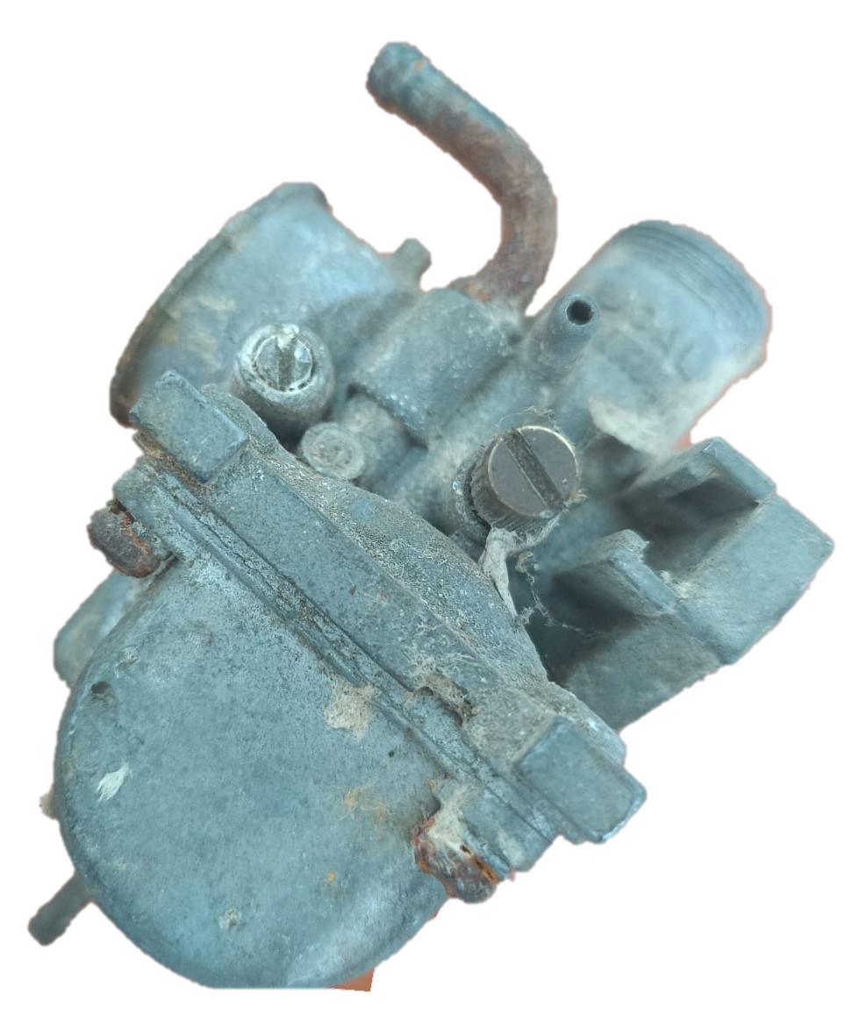
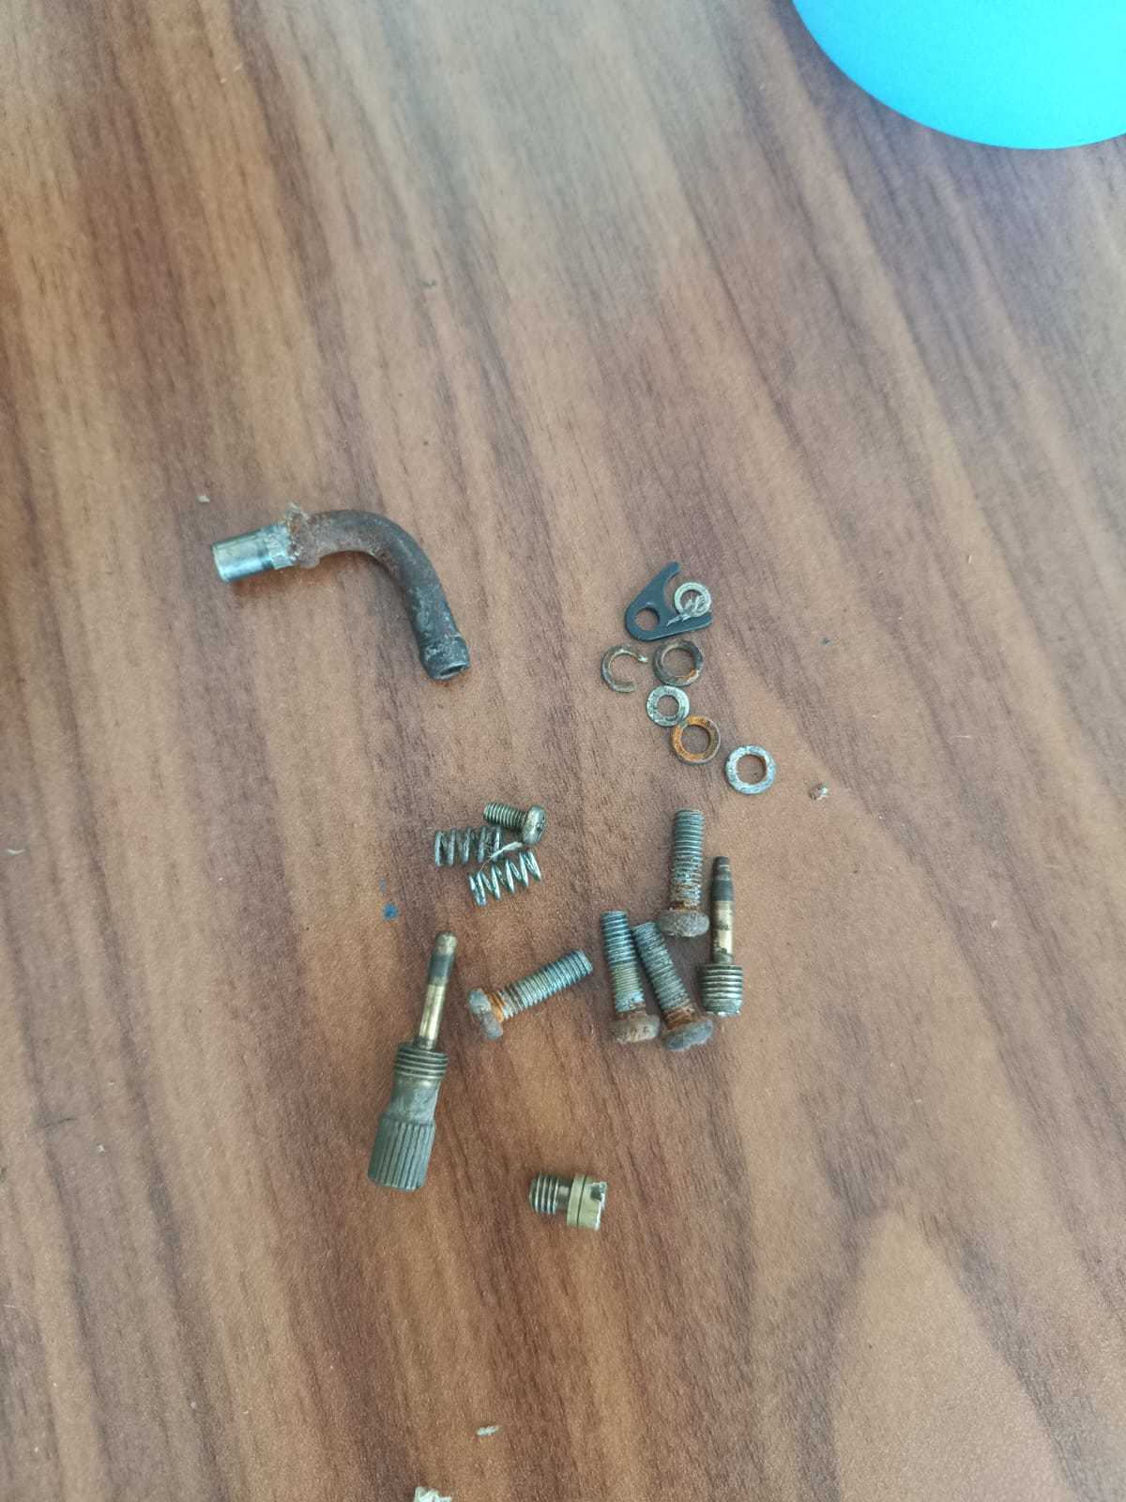
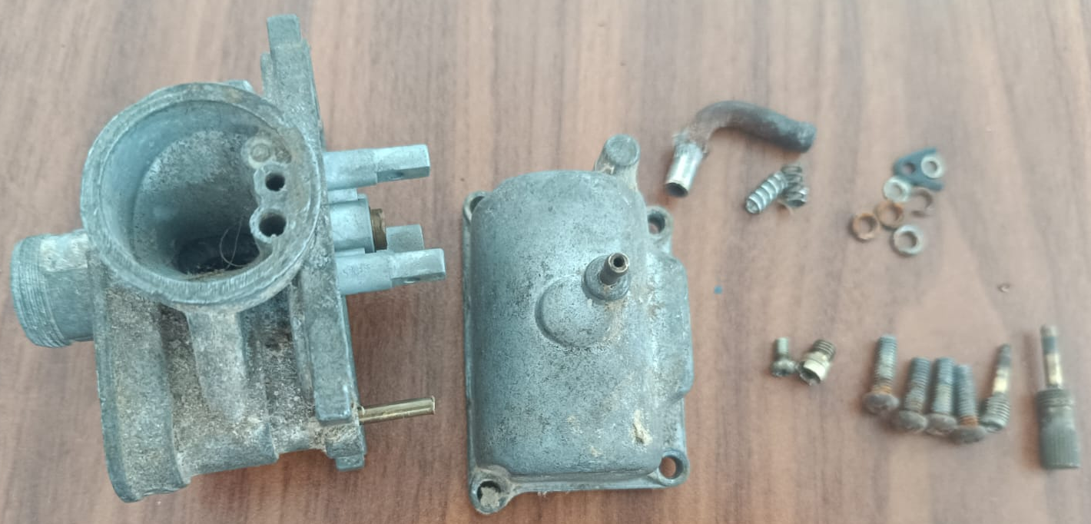
MADHAMSHETTY SATHVIKA
CARBURETOR ASSEMBLY (Yamaha RX-135)
EC23B1102
Float bowl screws(4)
Bowl screw
The carburetor was invented by Karl Benz in 1885 and got patented in the year 1886
Float bowl
carburetor screw
GI pipe bend
Springs(2)
Adapter drive slat
The oldest component in carburetor is coil spring.
Patented in the year 1763 by R.Tradwell

Slide 13
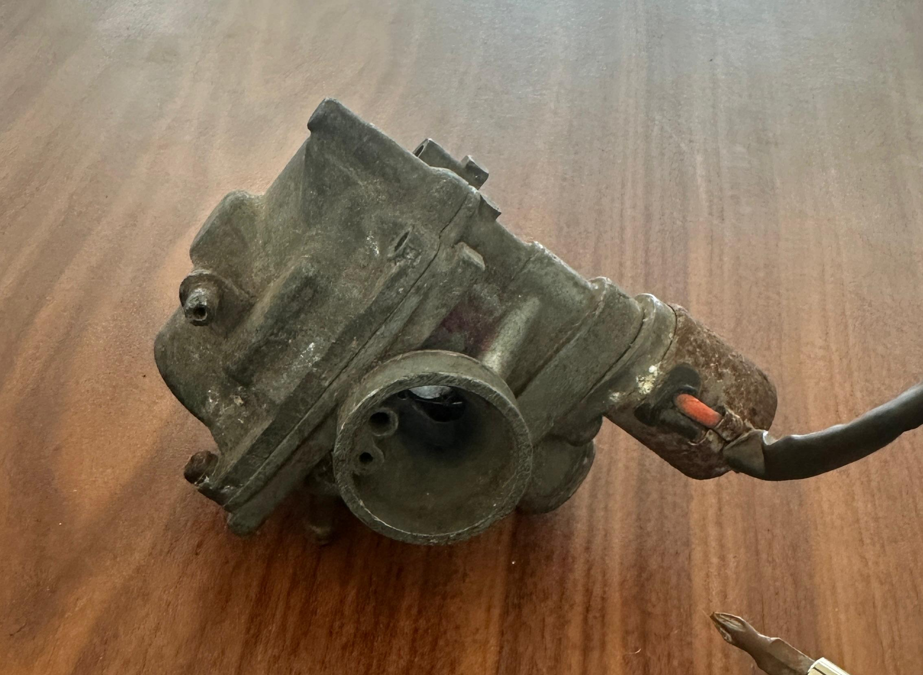
M.Akram Baig
EC23I2020
Oldest patented part : Main jet (CN2098561U)
Patented by Janos Csonka and Donat Banki in the year 1893

Slide 14
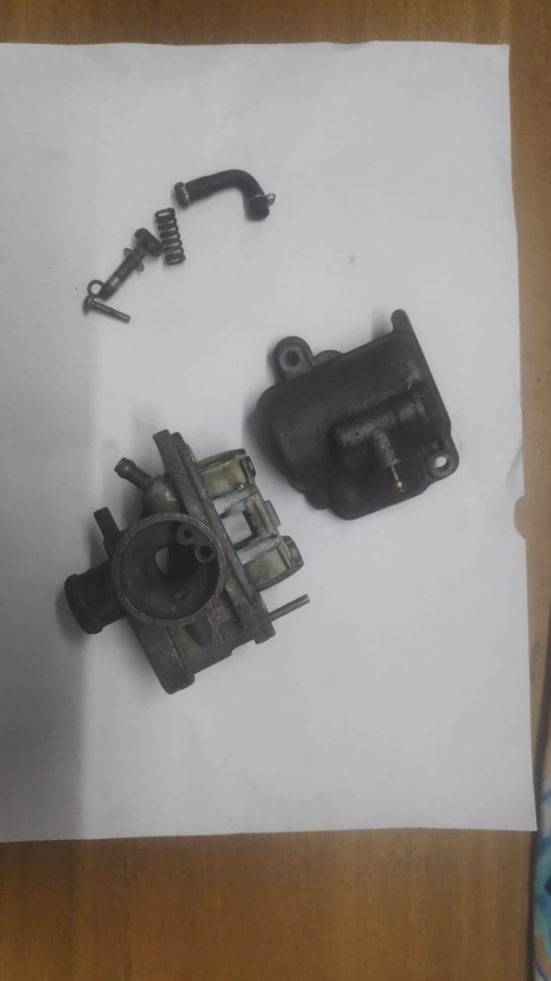
Parts of Carburetor
Main Body
Screws and Pins
Float bowl

Slide 15
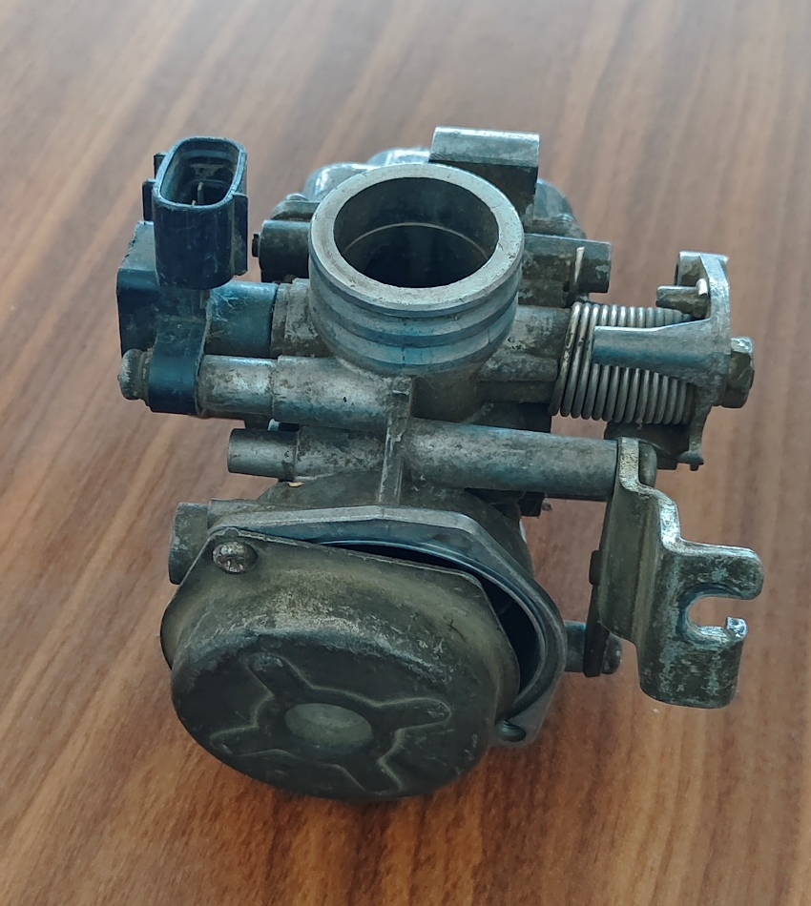
M.Someshwar Raj
EC23B1127
Oldest patented part : Main jet (CN2098561U)
Patented by Janos Csonka and Donat Banki in the year 1893

Slide 16
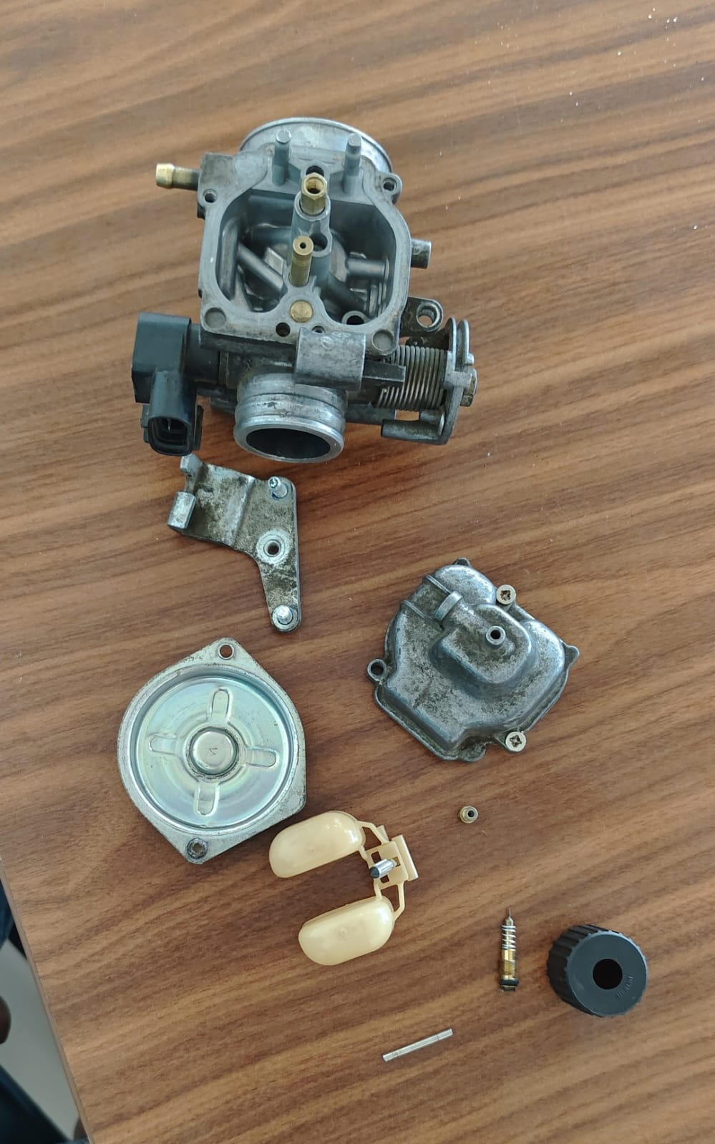
Parts of Carburetor
Screws and pins
Main Body
Float Bowl

Slide 17
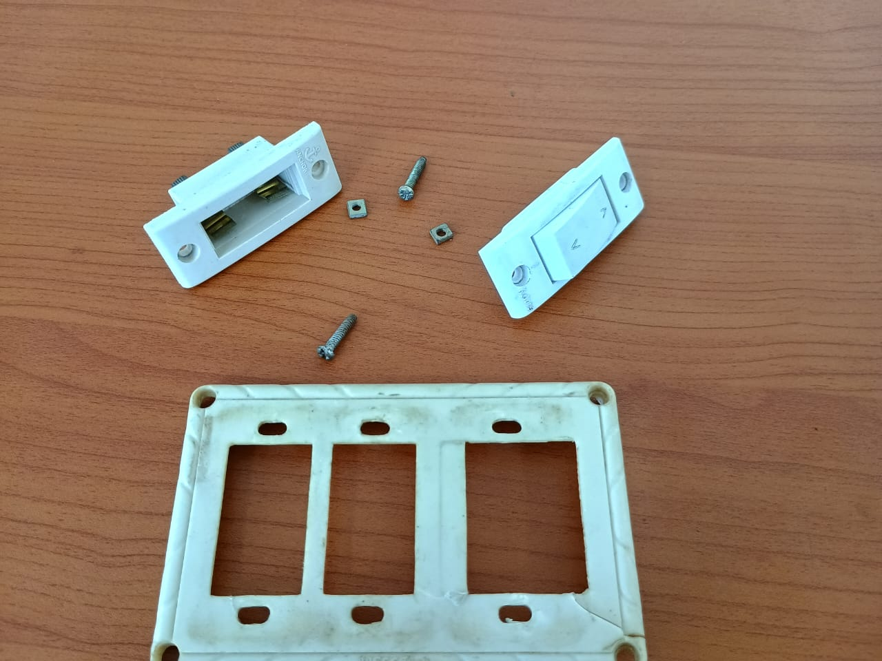
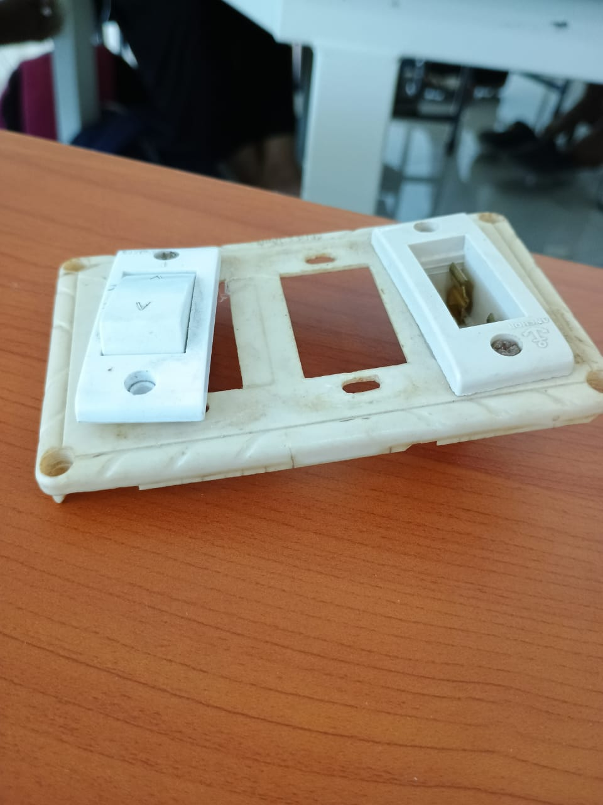
S.N.Akshaya
Electrical switch board
Components:
Square nuts-2
Switch -1
Switch board
Machine screws-2
Non Modular Socket-1
EC23B1031
After dismantling
Before dismantling
Patent details:(screw)
Inventor:Henry F Phillips
Patent No:US2046839A
Publication:07-07-1936

Slide 18
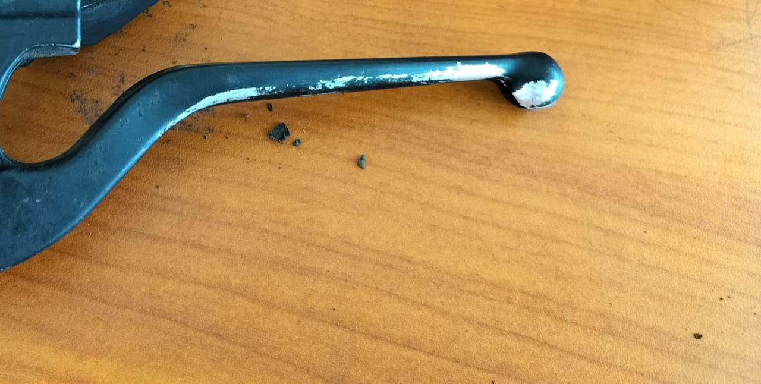
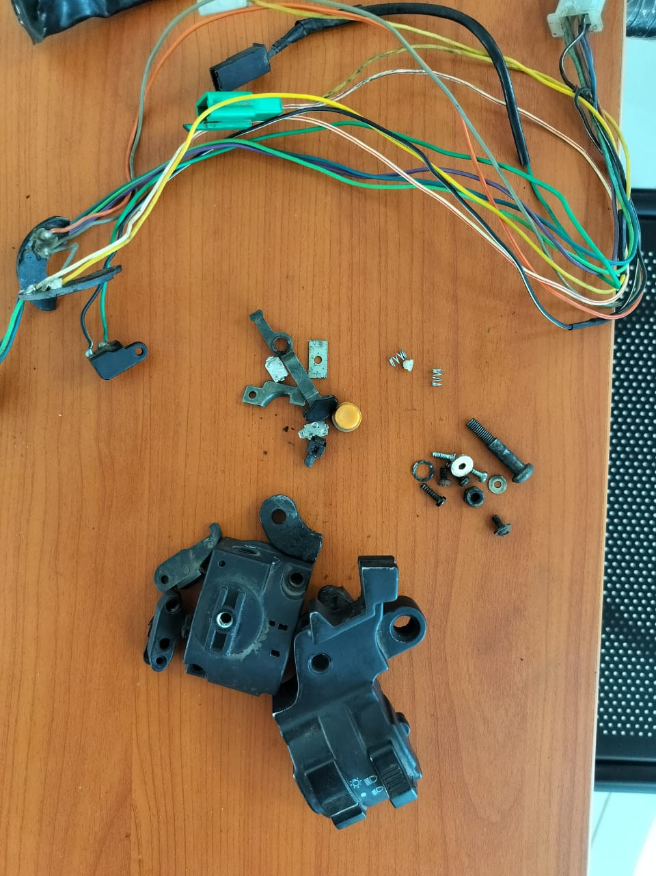
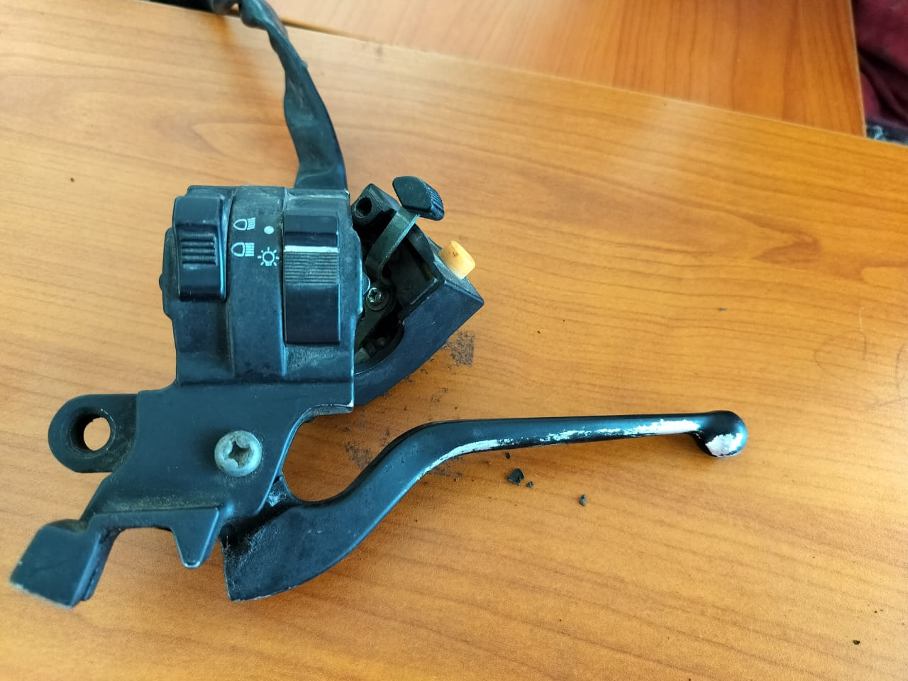
BRAKE
EC23B1120
A brake is a mechanical device that inhibits motion by absorbing energy from a moving system. It is used for slowing or stopping a moving vehicle, wheel, axle, or to prevent its motion, most often accomplished by means of friction.
INVENTION:
Rithanya
The first patent for a motorbike brake was filed by Gottlieb Daimler and Wilhelm Maybach in 1885. They patented a system for a two-wheeled vehicle with a brake acting on the rear wheel. This invention played a significant role in the development of motorbikes and automotive braking systems.

Slide 19
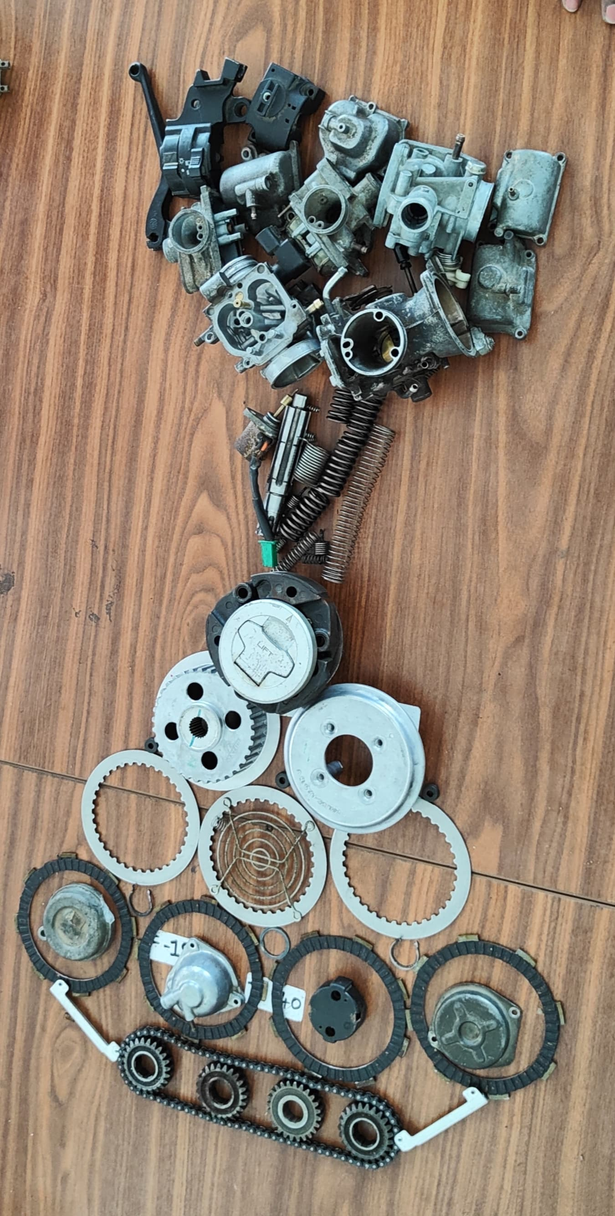
Scrap art based on similar shape.
All the dismantled parts which are of same shape
are made into one pattern and some random.

Slide 20
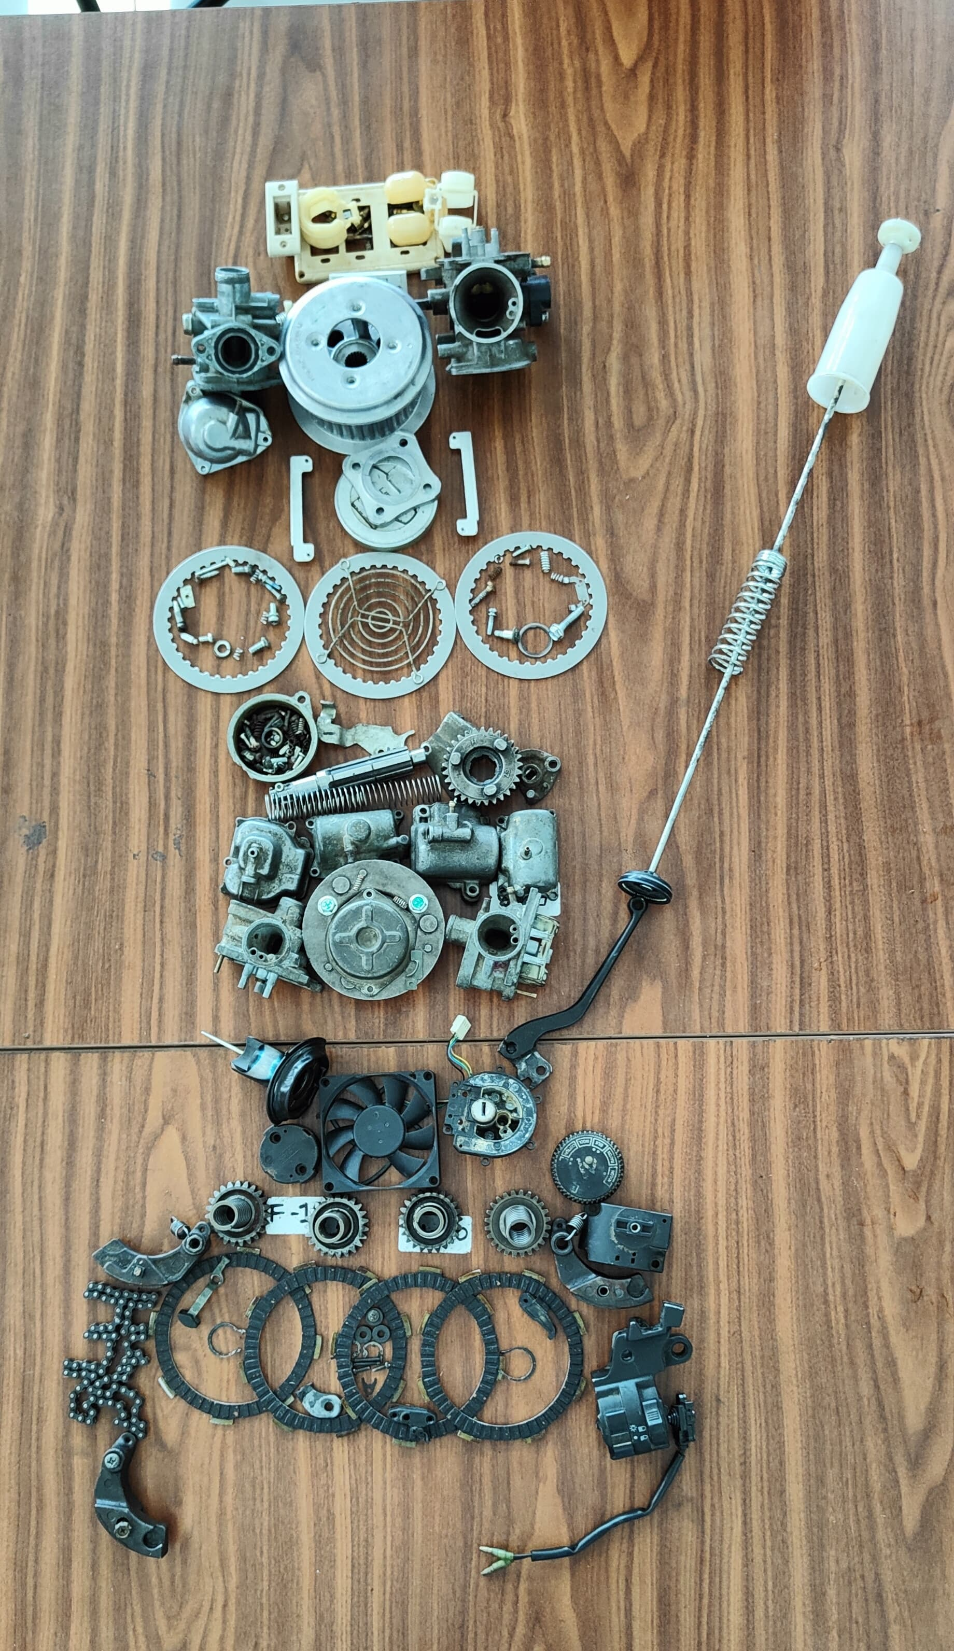
Scrap art based on colour property.
All colours which are similar placed at one place .

Slide 21
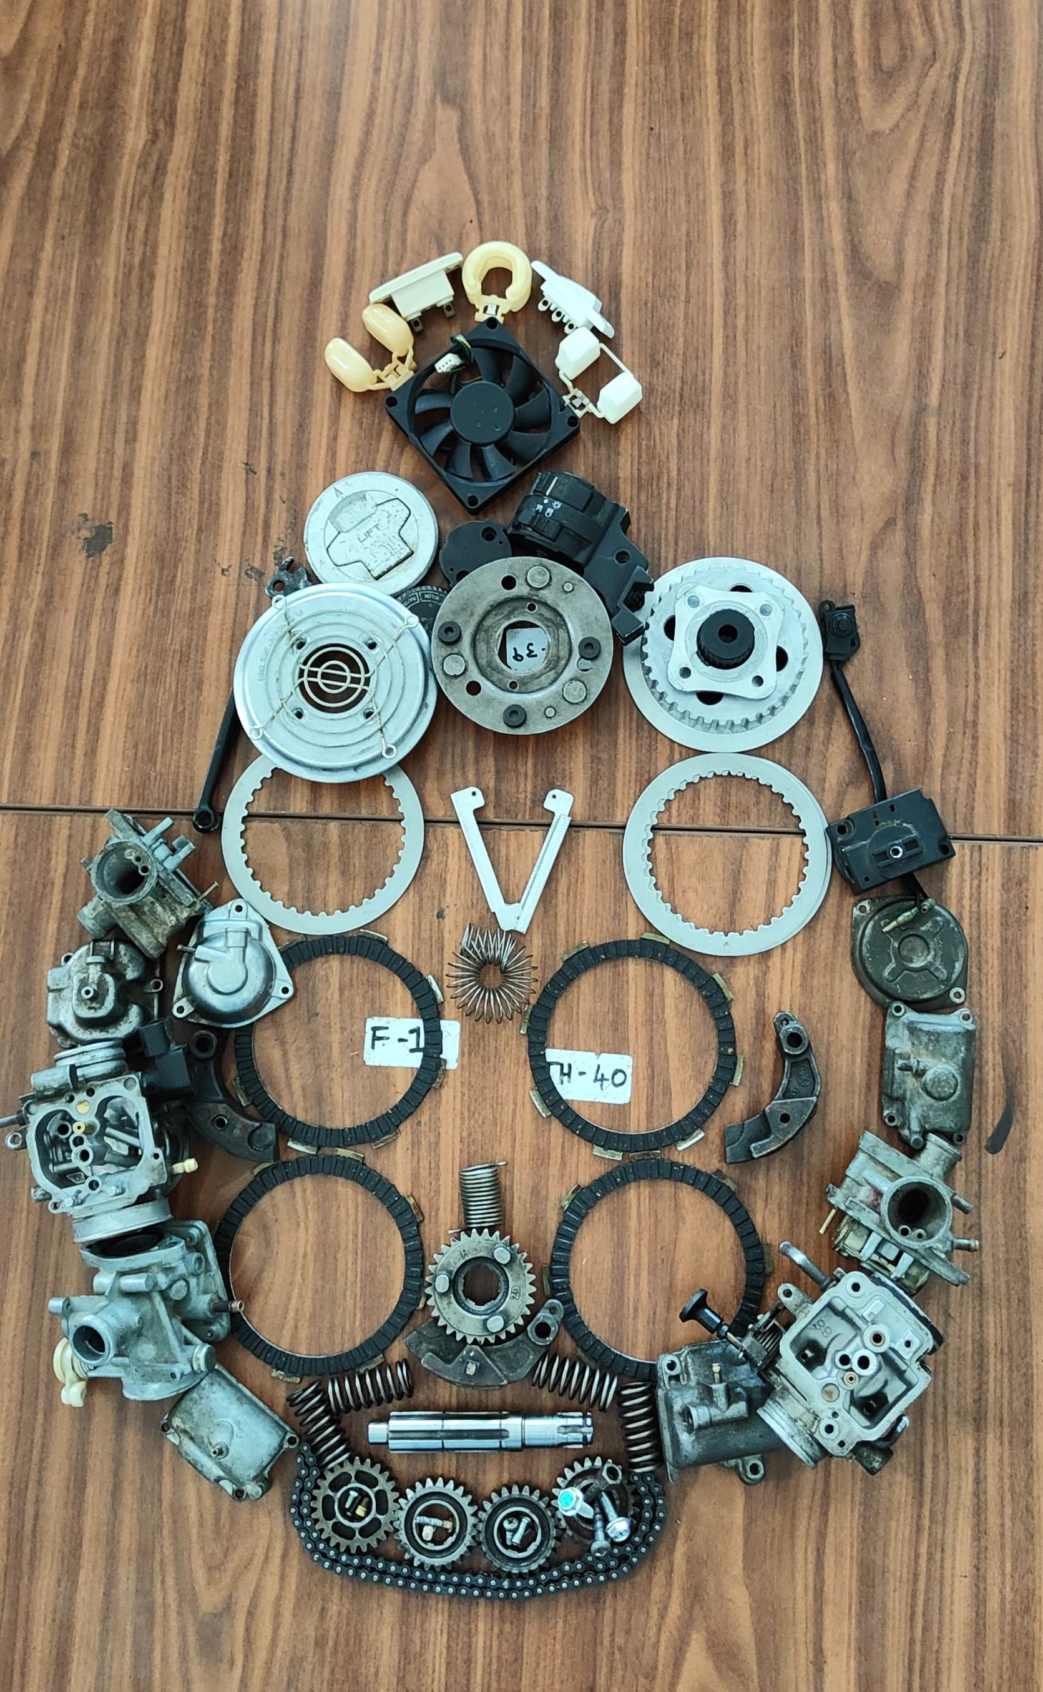
Scrap art based on strength of material .
As we go from top to bottom the material strength increases.

Slide 22
THANK YOU

